Slide 1
Public water supply grid monitoring to avoid water theft using IoT
BATCH.NO : 6
CH.SUMANTH 13SS1A0410
S.MAHITHA 14SS1A0404
M.SOUJANYA 13SS1A0434
GUIDE: MR B. PRABHAKAR
CO-GUIDE: MR B. RAVI

Slide 2
Contents
Introduction
Block diagram
AT89S52 microcontroller
Liquid crystal display
Sensors
ESP8266
Advantages
Applications

Slide 3
Introduction
In urban areas the water supply to residence and commercial establishments are provided at a fixed flow rate.
There are incidents of excess water drawn by certain customers/users i.e water will be released unofficially which is considered as water theft.
In this project it is proposed to develop an embedded based remote water monitoring and theft prevention system by taking the data of water supply at the consumer/user end.

Slide 4
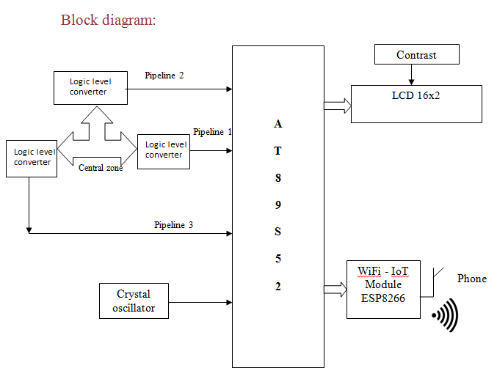
Block diagram
Power supply

Slide 5
Power supply
A 5V, 750mA power supply is used in this project.
The 230V AC is regulated to 5V DC.
TRANSFOR
-MER
RECTIFIER
SMOOTHING FILTER
REGULATOR
230V
AC
50KHZ
REGULATED
5V DC
BLOCK DIAGRAM OF REGULATED POWER SUPPLY SYSTEM

Slide 6
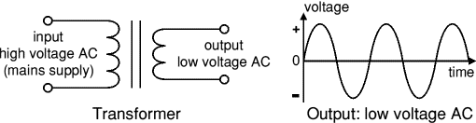
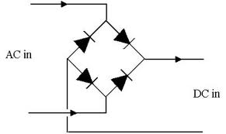
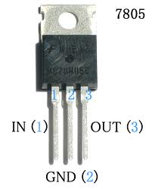
Contd...
A transformer steps down high voltage
AC mains to low voltage AC.
Full wave Bridge rectifier is used to
rectify the ac output of secondary of
230/12V step down transformer.
7805 three terminal voltage regulator
is used for voltage regulation.

Slide 7
AT89S52 Microcontroller
The AT89S52 is a low-power, high-performance CMOS 8-bit microcontroller with 8K bytes of in-system programmable Flash memory.
The on-chip Flash allows the program memory to be reprogrammed in-system or by a conventional nonvolatile memory pro-grammar.
Atmel AT89S52 is a powerful microcontroller which provides a highly-flexible and cost-effective solution to many embedded control applications.

Slide 8
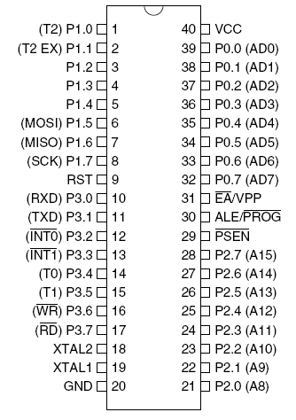
Pin diagram

Slide 9
Liquid crystal display (LCD):
A liquid crystal display (LCD) is a thin, flat panel used for electronically displaying information such as text, images, and moving pictures.
Its uses include monitors for computers, televisions, instrument panels, and other devices ranging from aircraft cockpit displays, to every-day consumer devices such as gaming devices, clocks, watches, calculators, and telephones.

Slide 10
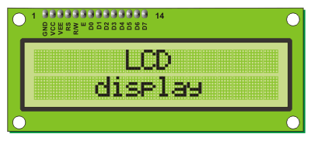
Among its major features are its lightweight construction, its portability, and its ability to be produced in much larger screen sizes than are practical for the construction of cathode ray tube (CRT) display technology.

Slide 11
Pin Description of LCD:
Ground
Vcc +5V
Contrast control
Register select (RS)
Read/Write (RD/WR)
Enable (EN)
7 – 14 pins all are data pins D0 – D7
Vcc +5V }
Ground }
For backlight purpose

Slide 12
Sensors
Reed switch or flow meter can be used to sense the flow of the water in the pipes.
The data is given to logic level converters and from the logic level converter to the microcontroller to check increase or decrease in flow

Slide 13
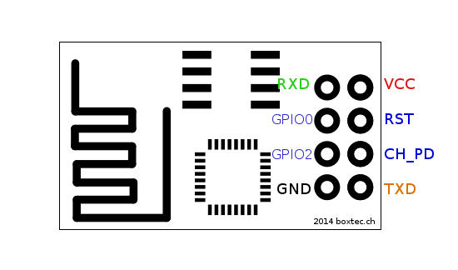
Pin Diagram of ESP8266

Slide 14
Features
802.11 b/g/n
Integrated low power 32-bit MCU
Integrated TCP/IP protocol stack
Integrated PLL, regulators, and power management units
WiFi 2.4 GHz, support WPA/WPA2
Support STA/AP/STA+AP operation modes
Support Smart Link Function for both Android and iOS devices

Slide 15
Softwares used
Embedded C
Keil
Proload

Slide 16
Advantages
Reliability
Ease of Operation
No need of human supervision

Slide 17
Applications
Water board
To prevent water man fraud
To monitor water leakage

Slide 18
References
www.electronicprojects.com
Electronics for u
Basic electrical engineering by v.k mehta

